Slide 1
ERASMUS SCOLARSHIP 2025-2026
ERASMUS + Grant
1.1 Rules
1.2 Eligibility and awarding criteria
1.3 Terms of payment
What documents do I need to provide?
2.1 Before the start of my mobility
2.2 As soon as I arrive
2.3 At the end of my mobility
3. FAQ - Contacts

Slide 2
1.1 Rules
Return all requested documents on time and take the necessary steps.
For the 80% as soon as possible after the arrival
For the 20% as soon as possible after the end of your semester
If you do not hand in the documents required to receive the 20% 30 days after your return and we do not receive any reply from you, we may ask for a refund of the 80% already received
3. If you have already benefited from the Erasmus+ grant as part of an exchange during your current study cycle (Bachelor or Master) you should contact the International Relations Department to check your remaining entitlements.

Slide 3
1.2 Eligibility and award criteria
Any student undertaking an Erasmus+ physical mobility is eligible for the Erasmus+ grant, regardless of nationality and financial situation.
Students undertaking a distance learning mobility from France are not eligible.

Slide 4
1.2 Eligibility and award criteria
The calculation of your scholarship is done automatically on the Erasmus Agency platform. This calculation considers the location of your mobility based on the zones defined by Erasmus according to the cost of living in each country and the duration of your exchange.
Germany
Austria
Belgium
Denmark
Finland
Ireland
Italy
Netherland
Norway
Sweden
Spain
Estonia
Greece
Latvia
Portugal
Slovakia
Slovenia
Czech Republic
Croatia
Hungary
Lituania
Poland
Turkey
Area 1
348€/month
Area 2
292€/month
Area 3
225€/month

Slide 5
Eligibility and award criteria
Destinations : UK and Hong Kong (China)
A new opportunity to benefit from an Erasmus grant for those studying abroad in the UK or Hong Kong (China), with financing limited to 2 months for a semester (UK) and 4 months for a Double Degree (UK or Hong Kong – China).
Hong Kong (China)
Only Double Degree = 4 months : 2800€ total
Travel Cost = 1500€
Hong Kong Baptist University (MGE)
United Kingdom
Semester = 2 months : 696€ total
Double Degree = 4 months : 1392€ total

Slide 6
1.2 Eligibility and Allocation Criteria
Support for Inclusion
You may receive an additional €250 to the monthly amount of your Erasmus+ scholarship. To qualify for inclusion support, you must meet one of the five criteria below and provide the required proof before the start of your mobility.
Criteria for Individuals
1. In a situation of disability or long-term illness (ALD)
2. Living in a municipality classified as a Rural Revitalization Zone (ZRR). Zonage de politiques publiques | L'Observatoire des Territoires (observatoire-des-territoires.gouv.fr)
3. Living at an address classified as a Priority Urban Area (Quartiers Prioritaires de la Ville) Quartiers de la politique de la ville | Ministère de la Cohésion des territoires et des Relations avec les collectivités territoriales (cohesion-territoires.gouv.fr) et pour le repérage des quartiers concernés SIG Politique de la Ville
4. Scholarship recipient in higher education based on social criteria, levels 6 and 7
5. Belonging to a household where the CAF Family Quotient is less than or equal to €566

Slide 7
1.2 Eligibility and Allocation Criteria
Eco-friendly transport
A contribution to student travel expenses is compulsory, with two distinct scales: standard and eco-responsible, applied according to the distance travelled as the crow flies between the DIJON campus and the host establishment. The means of transport considered to be eco-responsible are bicycles, buses, car-pooling and trains. The amounts awarded are as follows:
Distance traveled | Eco friendly transport | Standard transport
100-499 km | 285€ | 211€
500-1999 km | 417€ | 309€
2000-2999 km | 535€ | 395€
3000-3999 km | 785€ | 580€
4000-7999 km | 1 188€ | 1 188€
8000 km ou plus | 1 735€ | 1 735€
Please send supporting documents to the following address erasmus@bsb-education.com

Slide 8
1.3 Terms of payment
The Erasmus scholarship is not a monthly allowance. You will receive your scholarship in 2 instalments. To do this, you will need to send us these documents and complete the online formalities:
80 %
At your arrival
20 %
On your return
Learning Agreement
EHIC
Supplementary insurance
RIB
OLS test before mobility
Erasmus Mobility Contract
Arrival certificate
Certificate of attendance
OLS test after mobility
Erasmus participant report

Slide 9
BOURSE ERASMUS 2024 - 2025
2. What documents do I need to provide?
2.1 Before the start of my mobility
2.2 As soon as I arrive
2.3 At the end of my mobility

Slide 10
2.1 Before the start of my mobility : Learning Agreement
This document is to be submitted in your nominative file of your Teams group.

Slide 11
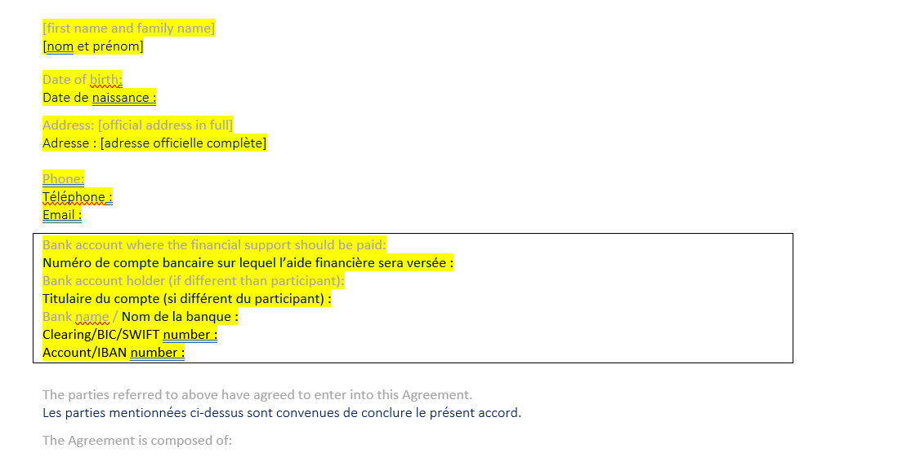
2.1 Before the start of my mobility : « Contrat de mobilité »
This document is to be submitted in your nominative file of your Teams group.
Contrat de Mobilité
Check pre-filled information
-Complete the parts highlighted in yellow
-Read the general terms and conditions
-Submit the document in Word format. Do not print, the document must be completed electronically.

Slide 12
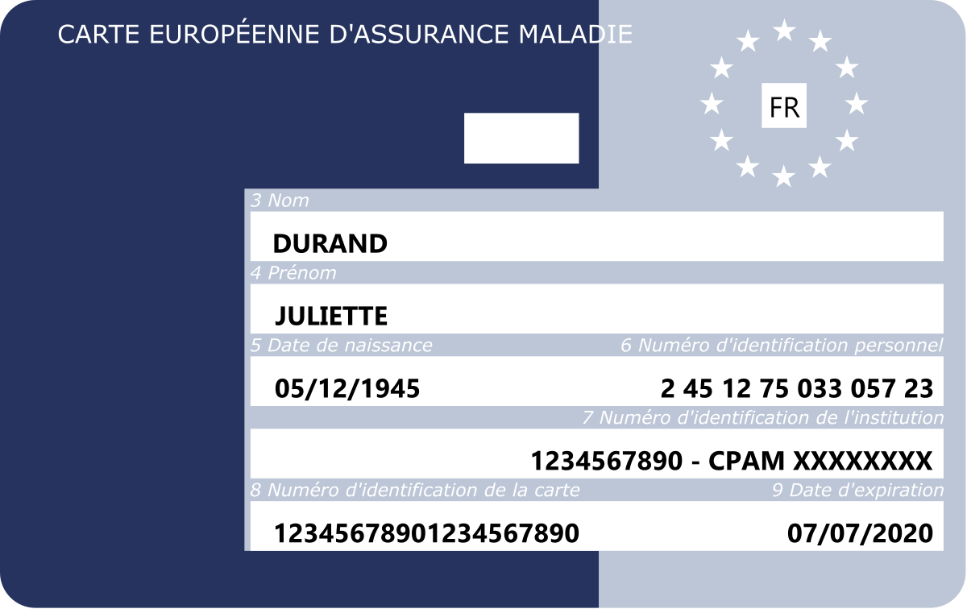
2.1 Before the start of my mobility : CEAM
This document is to be submitted in your nominative file of your Teams group.
CEAM (Carte Européenne d’Assurance Maladie)
To be requested on the Ameli.fr website Commander une carte européenne d'assurance maladie (CEAM) | ameli.fr | Assuré
You can send me the digital version of your EHIC available in the « My information » section in your Ameli space after your request.
If you already have an EHIC which will expire during your stay (before the end date), you must submit the renewal request 2 months before the end of validity.

Slide 13
2.1 Before the start of my mobility : Assurance complémentaire
This document is to be submitted in your nominative file of your Teams group.
Assurance Complémentaire
In addition to the EHIC, you must be covered for repatriation due to illness or accident. Check with your mutual insurance company, insurance company or bank insurance company as you may already be covered for these conditions abroad. If this is not the case, you will have to subscribe to a complementary European insurance with the guarantees mentioned above. BSB has signed a partnership with Chapka assurances which is a good option, but you can also choose another insurance company. With Chapka, you will benefit from a 10% discount on the Cap Student package with the code BSB10.

Slide 14
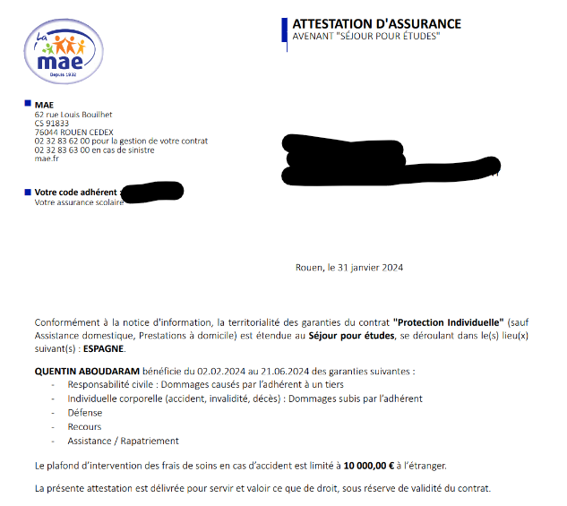
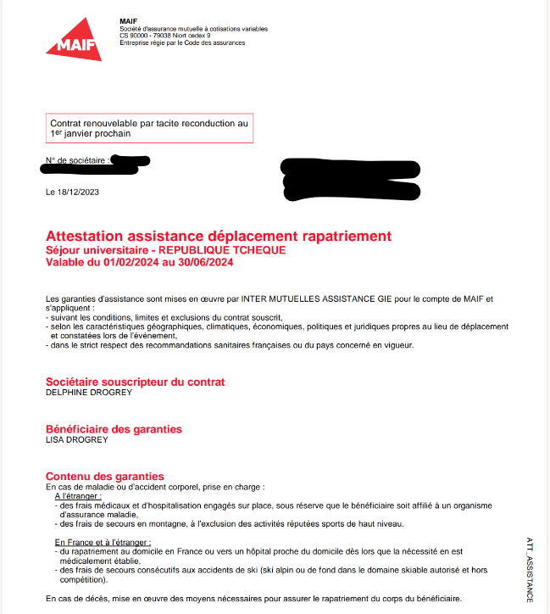
Exemple d’assurance complémentaire

Slide 15
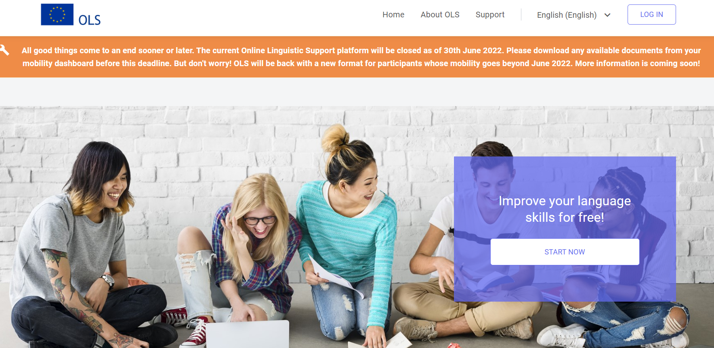
2.1 Before the start of my mobility : Test EU Academy
Test EU Academy
-You must take a language test in the language(s) of your Erasmus mobility: EU Academy -This test is compulsory -You must create an account and an EU login: https: //academy.europa.eu/courses/welcome-to-the-eu-academy to take the test in the language of instruction of your mobility. -Click on “Placement Test” in the search bar -Once you've taken the test, you'll need to download a certificate (take a screenshot if you have any problems), which you'll need to add to your Teams personal file. -This attestation is one of the documents required for the Erasmus grant. -Depending on your result, you may have access to online courses to help you improve your language skills. -For further information, see the “Tutorial EU Academy” document in your Teams group.
Remember to check your SPAMS!

Slide 16
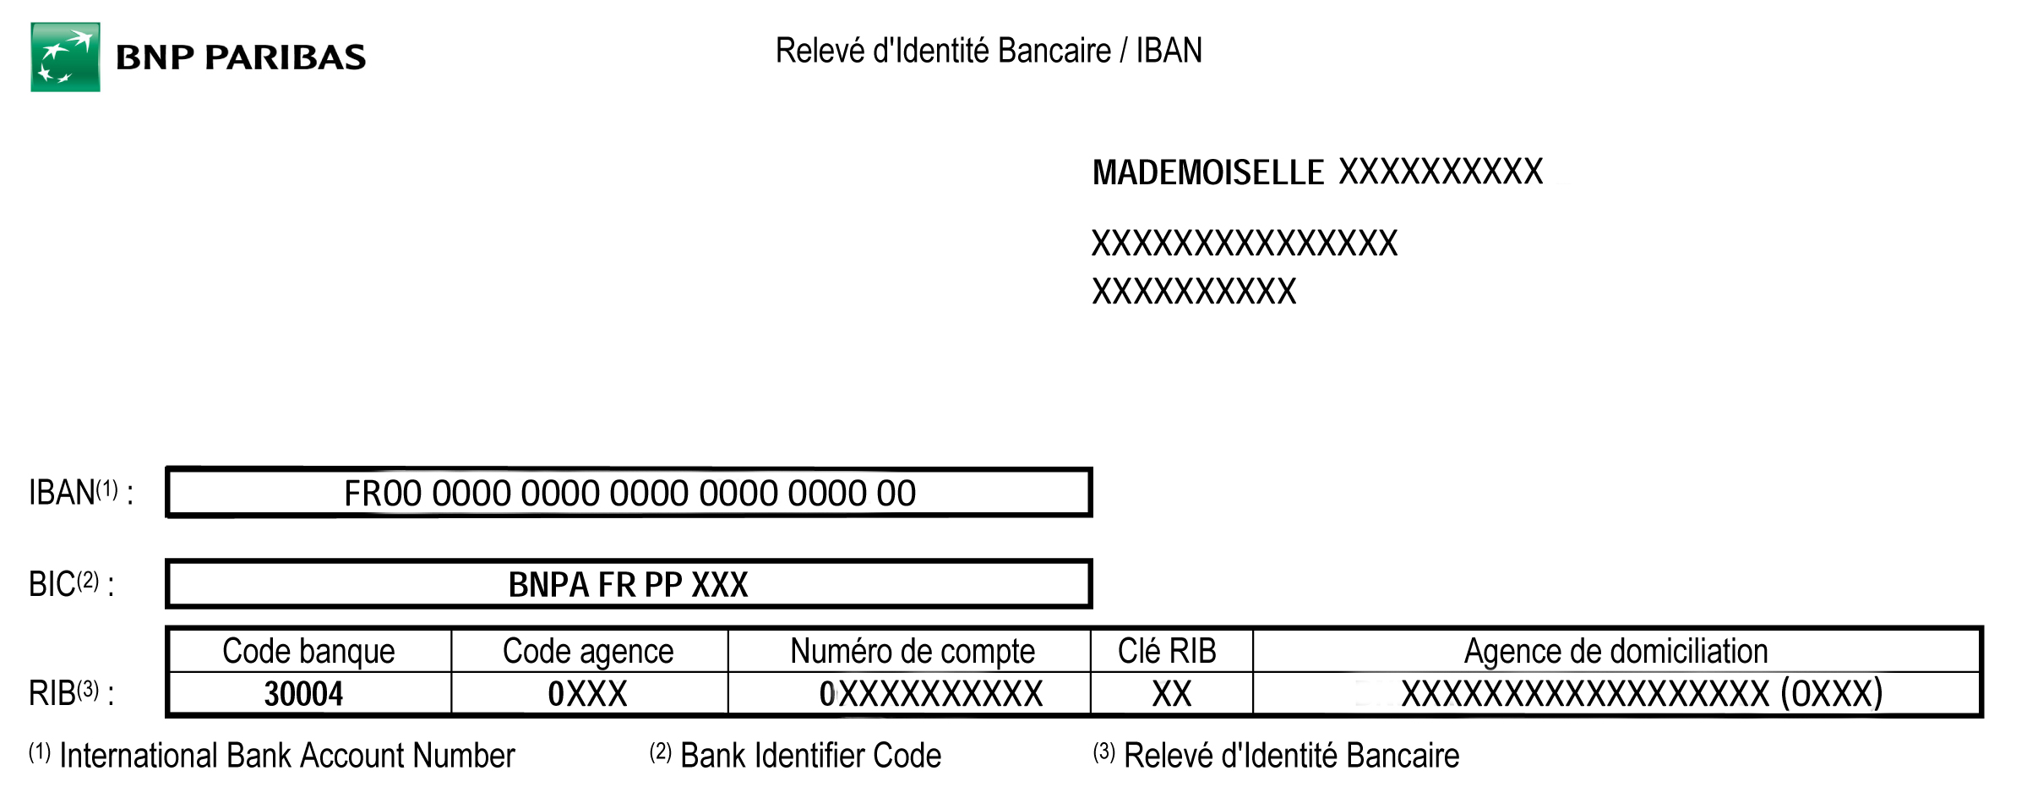
2.1 Before the start of my mobility : Bank identification
This document is to be submitted in your nominative file of your Teams group.
Bank identification
Bank identification in pdf
Please provide me with a PDF version of your French bank details (see example below, obviously it varies from bank to bank):
No photo
No Word file, OneNote,...

Slide 17
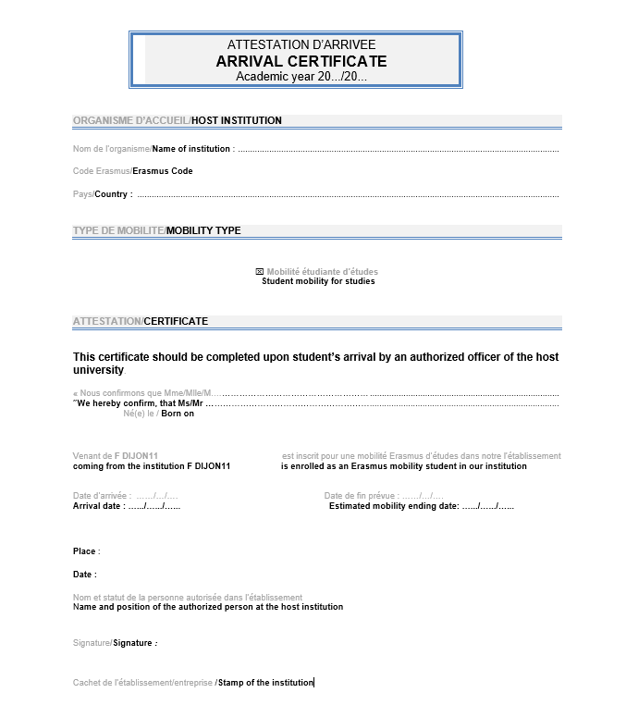
2.1 Before the start of my mobility : Bank identification
On your arrival, you will have to deposit your arrival certificate in your Teams file.
This document must be completed, stamped and signed by the partner with the following information
Arrival Date 1st day of the integration day or 1st day of the course. This is not your arrival day in the country!
Estimated mobility ending date Estimated mobility ending date (including exams)
Signature date Any backdated certificate will not be accepted!
You cannot send me a document with an arrival date of 12/01/2022 and a signature date of 11/01/2022
Contact me via Teams that the document is submitted! Otherwise the payment of the grant cannot be triggered!

Slide 18
What documents do I need to provide to get the 20% ?
This document is to be placed in your personal file of the starting TEAMS group.
Part 1
Part 3
Attendance Certificate
Erasmus Student Report

Slide 19
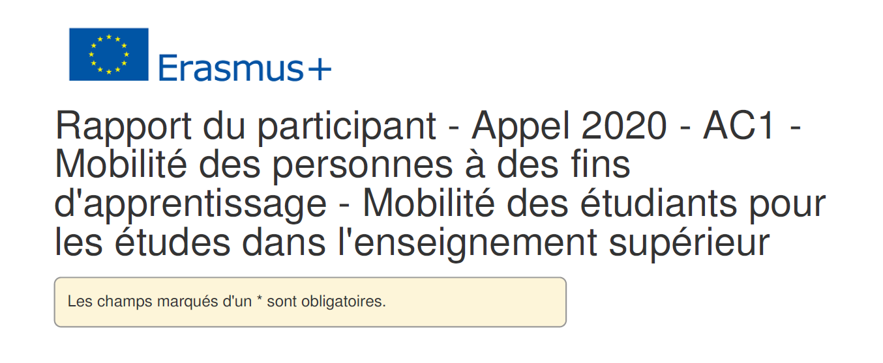
2.3 At the end of my mobility : Rapport Erasmus
Rapport de l’étudiant ERASMUS
Please fill in this report carefully as your answers have an influence on the evaluation of BSB by the Erasmus Agency and have an impact on the funding of future Erasmus students of BSB. We count on you to understand what is at stake with your answers in this report.
Don’t forget to check your spams !

Slide 20
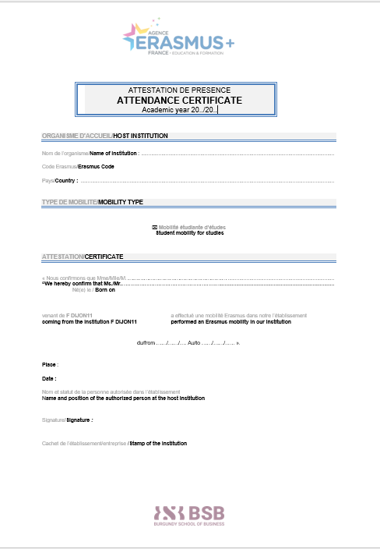
2.3 At the end of my mobility: Certificate of attendance
This document is to be placed in your personal file of the starting TEAMS group.
At the end of your mobility, you will have to submit your certificate of attendance.
This document must be completed, stamped and signed by the partner with the following information
From/From 1st day of the integration day or 1st day of the course. This is not your arrival day in the country!
To/to Last day of exams at the partner
Date of signature Backdated certificates will not be accepted!
You cannot send me a document with an end date of 12/06/2022 and a signature date of 11/06/2022. But the form can be signed a few days after the end date of your mobility.
Contact me via Teams that the document is submitted! Otherwise, the payment of the grant cannot be triggered!

Slide 21
3. FAQ

